Slide 1


Crime Prediction Analytics using Supervised Learning Algorithms
By
Kariman Karm Mohamed Mousaa
Queen’s Supervisor
DR. Anwar Hossain
DEBI Supervisor
DR. Mona Farouk

Slide 2
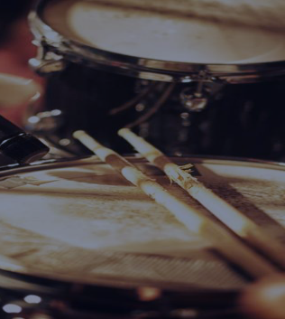

agenda
Problem Definition​
Motivation
Related work
Methodology
Results
Conclusion
Future work
References

Slide 3

Problem Definition​
- The number of crimes has increased and there is a need to classify crimes.
- Comparison between the types of crime From Toronto and Vancouver dataset .

Slide 4

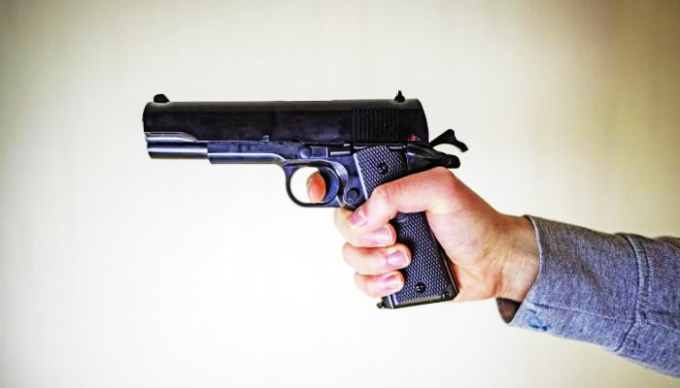

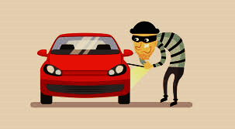

Motivation
4

Slide 5
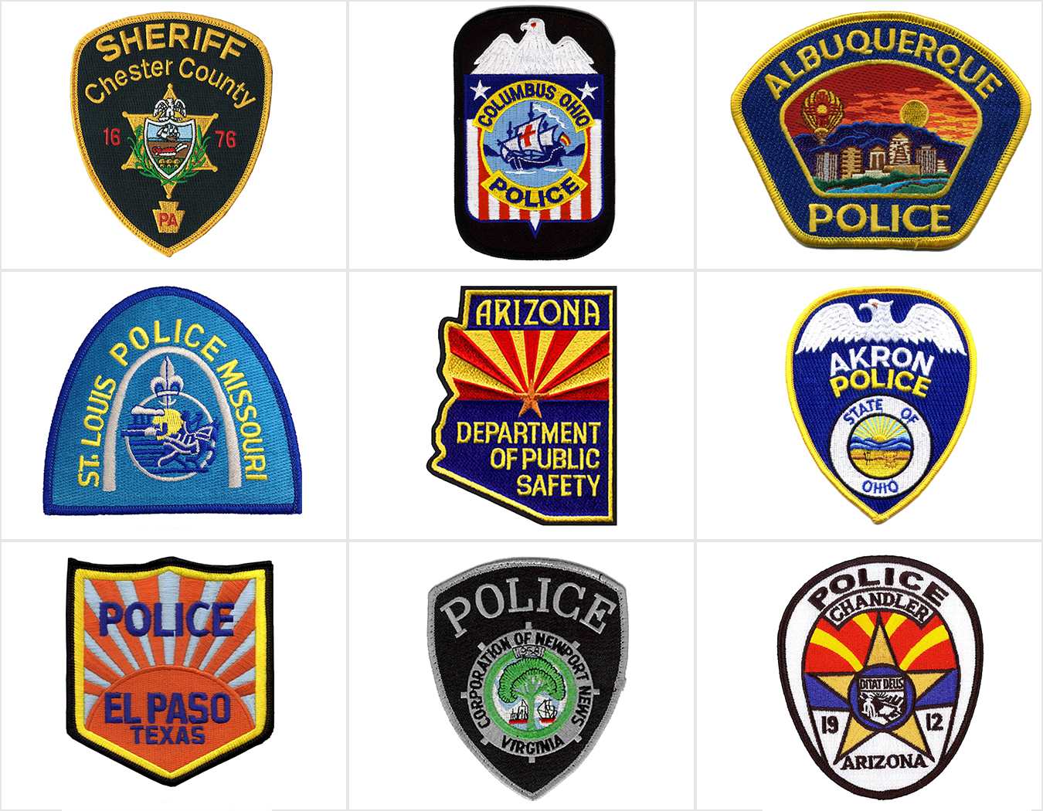
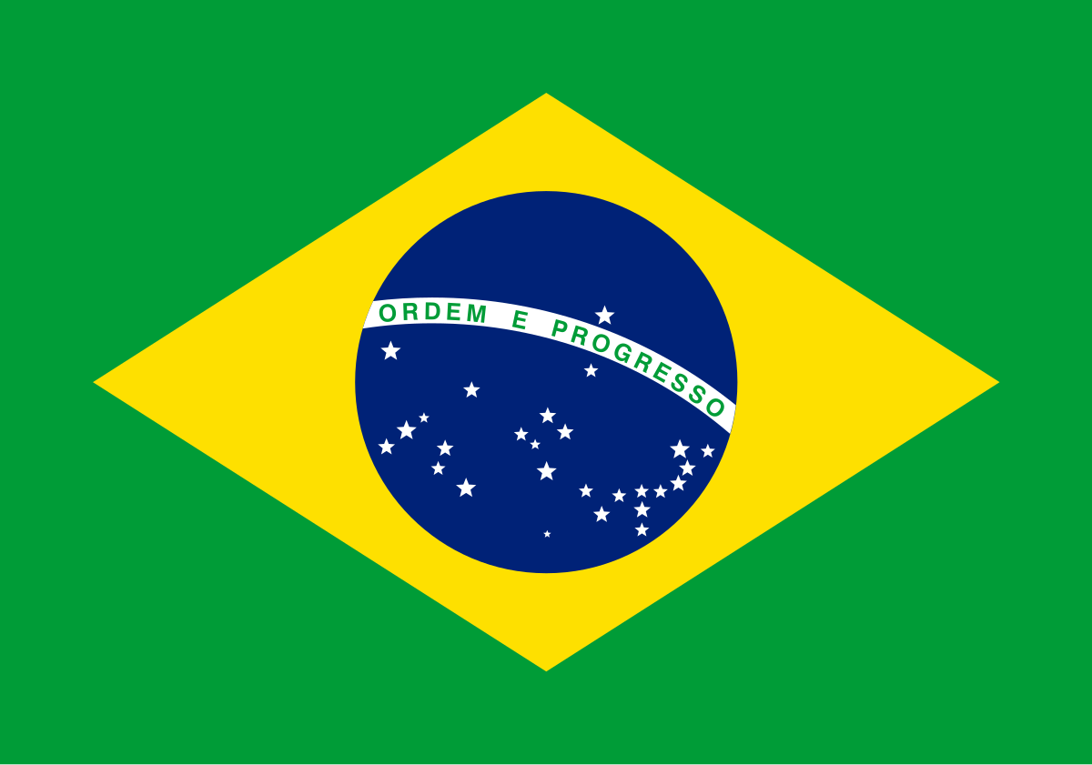


Related work
There are several techniques reported in the scientific research that can be used to predict and classify in crime predict ​
Law enforcement agencies,
The best algorithm was decision tree with
F1 equal to (.761)
violent crimes in Brazil,
The best algorithms are Random Forest and XGBoost
The best algorithm is Random Forest with F1 equal 0.190 and with Log loss equal 16.7994
The best algorithm is Naive Bayes.

Slide 6
Methodology
Data
Feature Engineering
EDA
Data Pr-Processing
Evaluation
Model
​

Slide 7
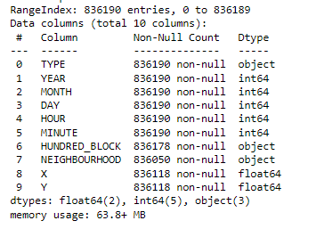
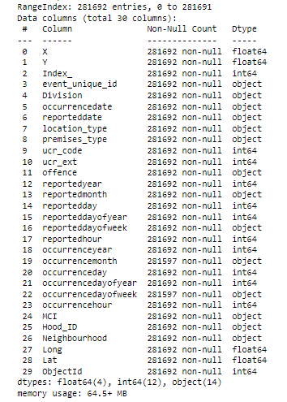
Datasets
Toronto
Vancouver

Slide 8
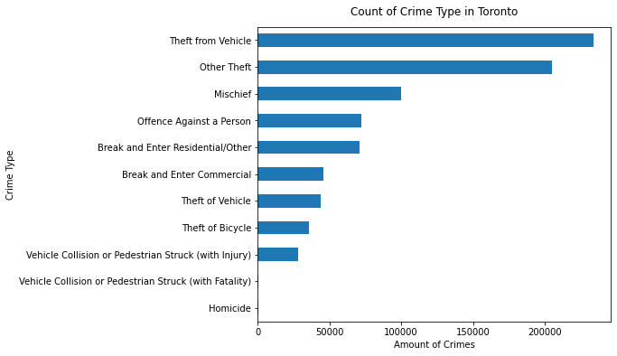
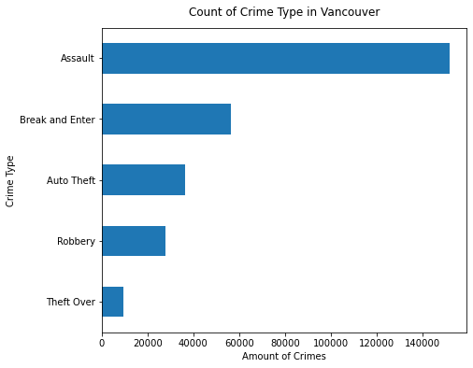
EDA

Slide 9
Data pr-Processing
Duplication (Toronto)
Missing data
Datatype occurrence month convert to numerical

Slide 10
Feature Engineering
Insert new columns(holiday, weekend)
Unuseful Feature
High Correlation

Slide 11
Model
KNN
It didn't fit
Naïve bayes
The worst f1 and accuracy
The best f1 and accuracy
XGBoost and Random Forest
normalize

Slide 12
Evaluation
Classification report
F1 score
Accuracy score

Slide 13
Results
Toronto
Vancouver
KNN:
F1=.45, accuracy=.75
Naïve bayes:
F1=.33, accuracy=.73
Random Forest:
F1:.78, accuracy=.93
XGBOOST:
F1=.79, ACCURACY=.93
Random Forest:
F1=.70, accuracy=.64
XGBOOST:
F1=.71, ACCURACY=.64
- AFTER REGROUPING THE TYPE OF CRIME:
Random Forest:
F1=.75, accuracy=.82
GOING WORK TO IMPROVE

Slide 14
comparison between related work and current work in the results
Algorithms(f1) | Toronto | Vancouver | Law enforcement agencies
Decision Tree
Random Forrest
XGBoost
Naive Bayes

Slide 15
Conclusion
In Toronto, the features were not enough and not strong to shoulder the type of crime. But in Vancouver ,It was better, as there were features that helped predict the type of crime, but there are still some classes that were not good at predicting them, and still going work to improve.

Slide 16

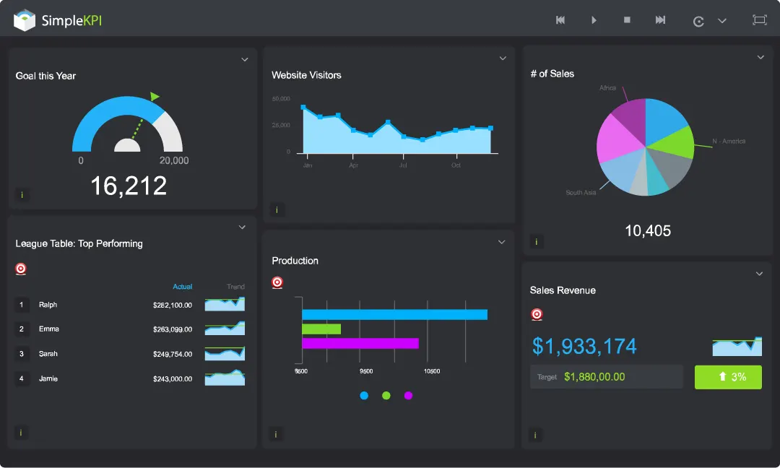

Future work
Get more data or different data to help to classify the types of data.
A website or application in which all data for tourist or immigration areas are collected to help people avoid.
Dashboard

Slide 17
References
[1] google crime images
Image1, Image2, Image3, Image4, Image5,6 , IMAGES6,7,8
[2] O. Llaha. Crime analysis and prediction using machine learning. pages 496–501,09 2020. doi: 10.23919/MIPRO48935.2020.9245120.
[3] U. Rosa Monteiro de Castro, M. Rodrigues, and W. Brand˜ao. Predicting crime by exploiting supervised learning on heterogeneous data. 05 2020. doi: 10.5220/0009392005240531.
[4] D. Sardana, S. Marwaha, and R. Bhatnagar. Supervised and unsupervised machine learning methodologies for crime pattern analysis. International Journal of Artificial Intelligence Applications, 12:83–99, 01 2021. doi: 10.5121/ijaia.2021.12106.

Slide 18

THANKS FOR LISTENING
Kariman Karm Mohamed Mousaa
21kkmm@queensu.ca

